Slide 1
Music information retrieval (MIR) open issue [link]
Sound feature
Pre-processing
Traditional method
Deep learning method
Noise cancelation

Slide 2
MIR
Fingerprint [MIREX]
Cover song detection[MIREX]
- parallel CNN
Genre recognition[MIREX]
- CNN
Transcription 採譜
- LSTM
Recommendation
Symbolic melodic similarity[MIREX] - MIDI相似性
Moon情緒[MIREX]
Source separation
Instrument detection
Pitch tracking
-CNN/DNN/RNN
Tempo estimation [MIREX] 速度
- [MIREX 2016 P-score 0.89]
Score alignment [MIREX][audio 2 midi]
-RNN[link][link] [MIREX 2016 total precision 97.43%]
Song structure/form
Beat tracking [MIREX]
- BLSTM (2011) [MIREX 2016 F-measure 73.89%]
Key detection [MIREX]
Query by humming [MIREX]

Slide 3
Training schedule for sound

Slide 4
resource
Sound signal introduction and feature extraction
https://mirlab.org/jang/books/audioSignalProcessing/
Music signal retrieval and analysis (音樂訊號檢索與分析) http://u.camdemy.com/course/1306/intro
Stanford MIR lab , Notes on Music Information Retrieval https://github.com/stevetjoa/stanford-mir (python librosa package)
Traditional Speech process
數位語音處理概論 http://ocw.aca.ntu.edu.tw/ntu-ocw/ocw/cou/104S204/7
Deep learning on Speech Recognition
Stanford CS224D Guest Lecture: Andrew Maas - Lectures from 2015
Andrew Maas co-work with Andrew NG from 2011
https://www.youtube.com/watch?v=6D8_4GkEWUg&index=13&list=PLCJlDcMjVoEdtem5GaohTC1o9HTTFtK7_
Youtuber Siraj Raval Music Generation https://www.youtube.com/playlist?list=PL2-dafEMk2A5-sn0Sgkw-4q-Lw0jiuQtu

Slide 5
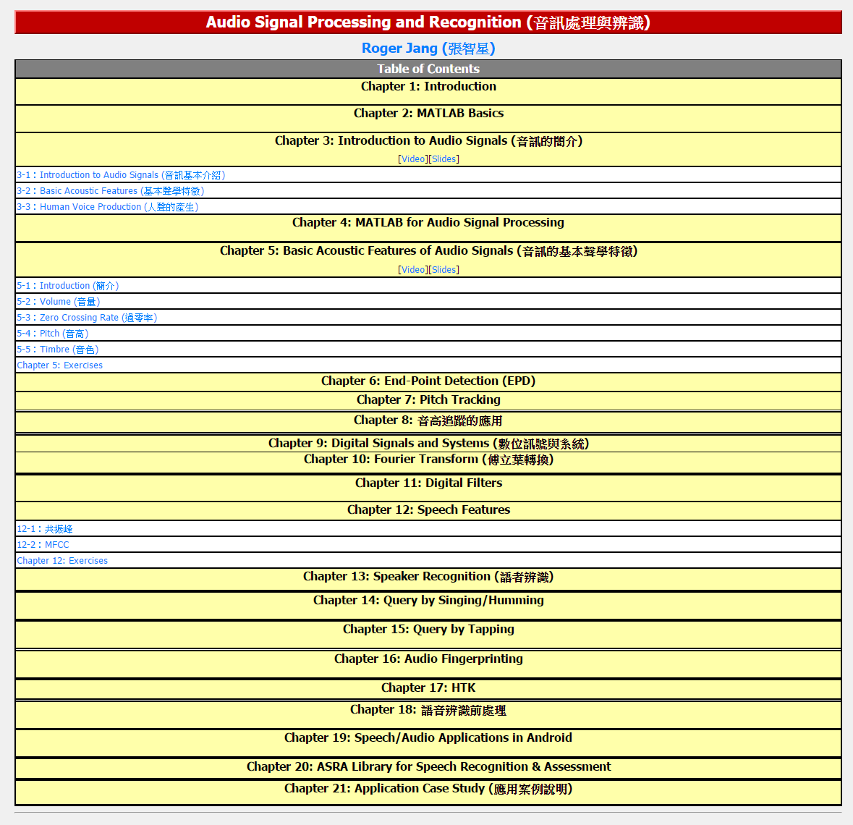
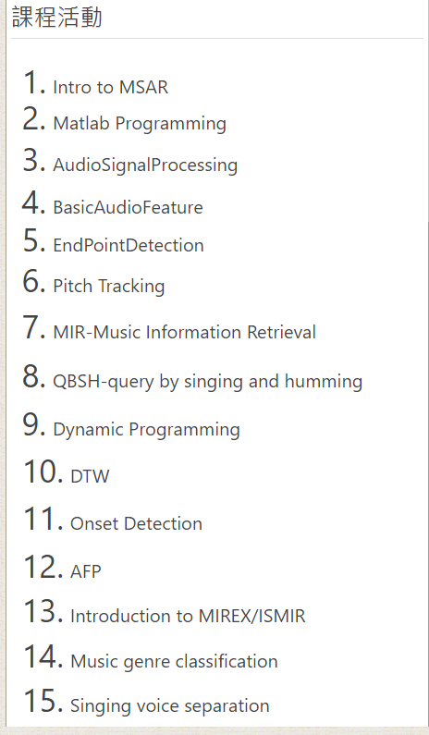
NTU 張智星
url: https://mirlab.org/jang/books/audioSignalProcessing/

Slide 6
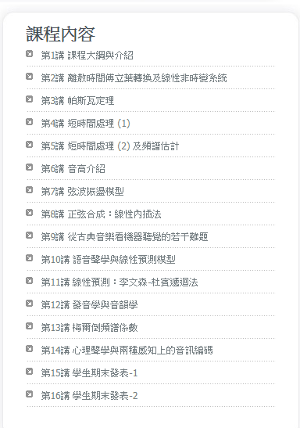
NTHU 劉奕汶
劉奕汶
國立清華大學電機工程學系 教授 學歷：美國史丹佛大學電機博士 經 歷： ＊國立清華大學102傑出教學獎 ＊教學網站：http://www.ee.nthu.edu.tw/ywliu/ ＊授課領域：數位聲訊分析與合成、數位訊號處理、機率、 線性代數、類神經網路 ＊研究專長：信號處理, 聽覺科學
http://ocw.nthu.edu.tw/ocw/index.php?page=course&cid=130&

Slide 7
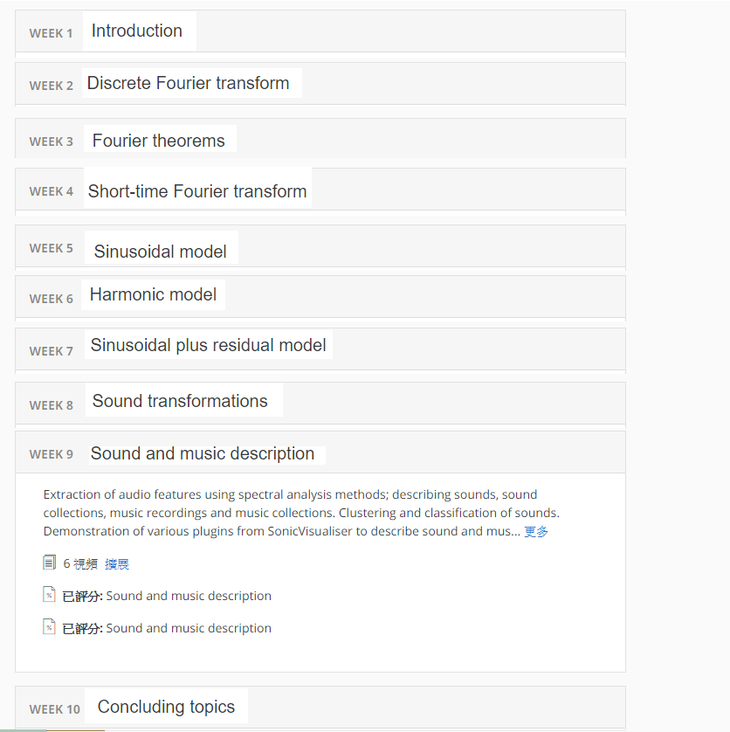
Coursera - Audio Signal Processing for Music Applications

Slide 8
Beat Tracking dataset

Slide 9
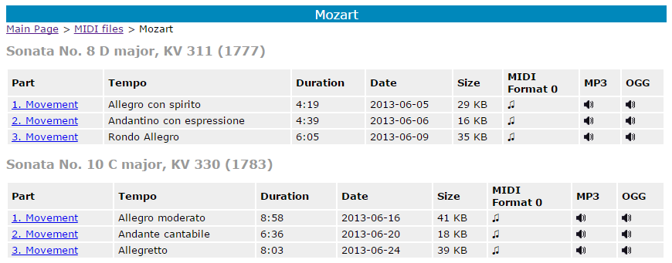
Piano database
http://www.piano-midi.de/
Author 25, Album 96, Song 332
Format: MIDI, F0, MP3, OGG

Slide 10
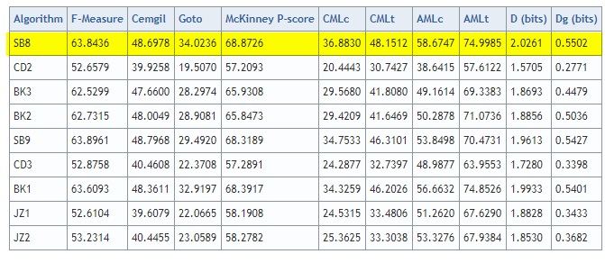
MIREX 2016 - MCK dataset
http://www.music-ir.org/mirex/wiki/2016:MIREX2016_Results
Evaluation definition: https://www.researchgate.net/publication/268132820_Evaluation_Methods_for_Musical_Audio_Beat_Tracking_Algorithms

Slide 11
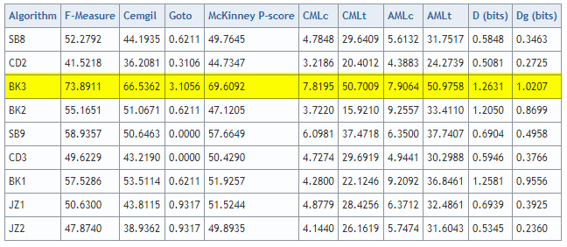
MIREX 2016 - MAZ dataset
http://www.music-ir.org/mirex/wiki/2016:MIREX2016_Results

Slide 12
Cover song detection

Slide 13
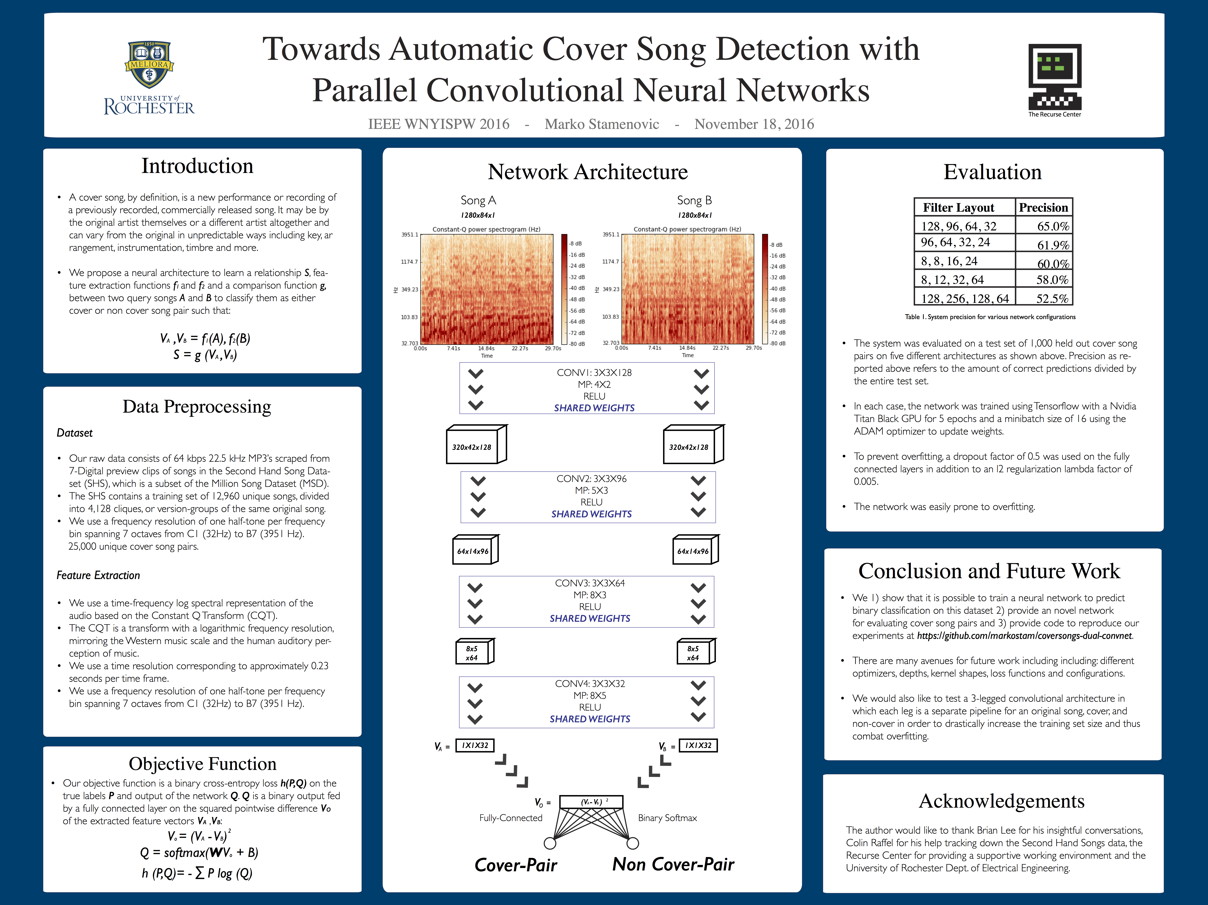
https://github.com/markostam/coversongs-dual-convnet

Slide 14
Score alignment

Slide 15
